Slide 1
Cloud Performance Engineering in DevOps
Java Performance Engineering
Raushan Kumar

Slide 2
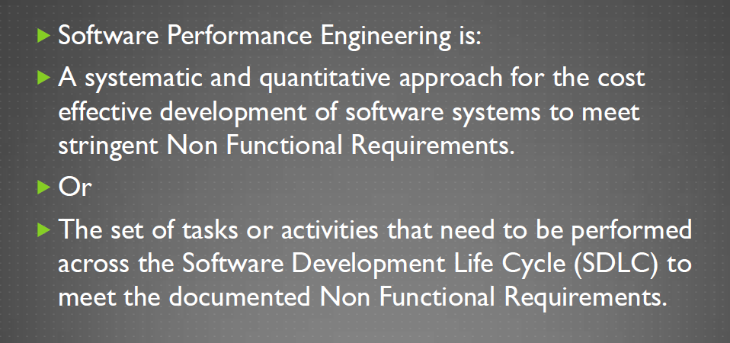
Software Performance Engineering (SPE) - Definition
Raushan Kumar

Slide 3
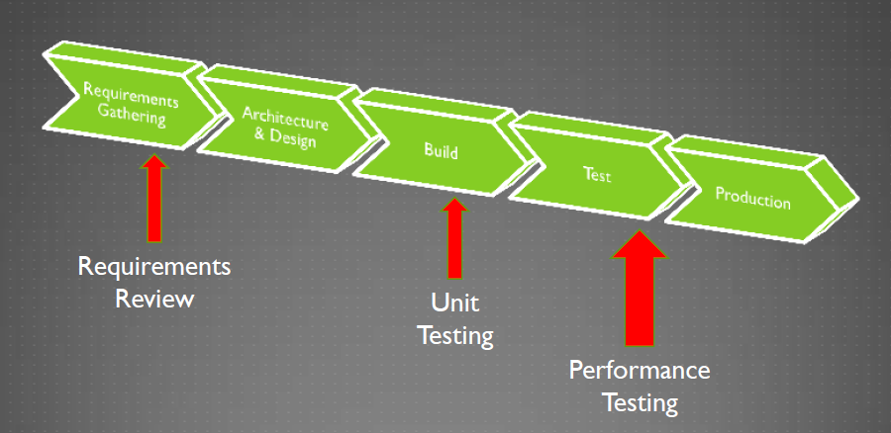
Performance Testing in the SDLC
Raushan Kumar

Slide 4
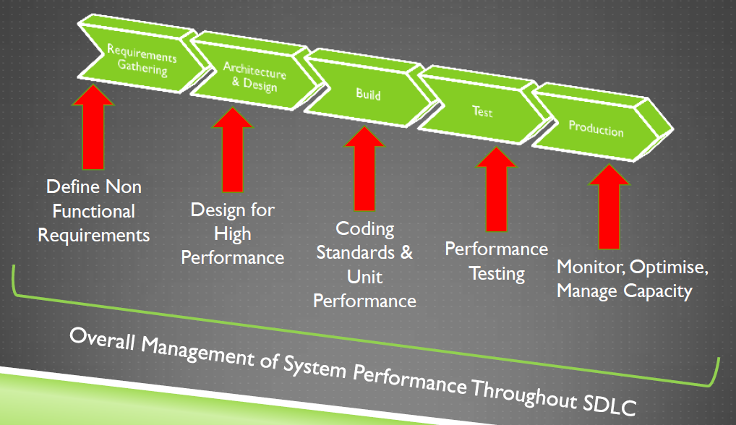
Performance Engineering in the SDLC
Raushan Kumar

Slide 5
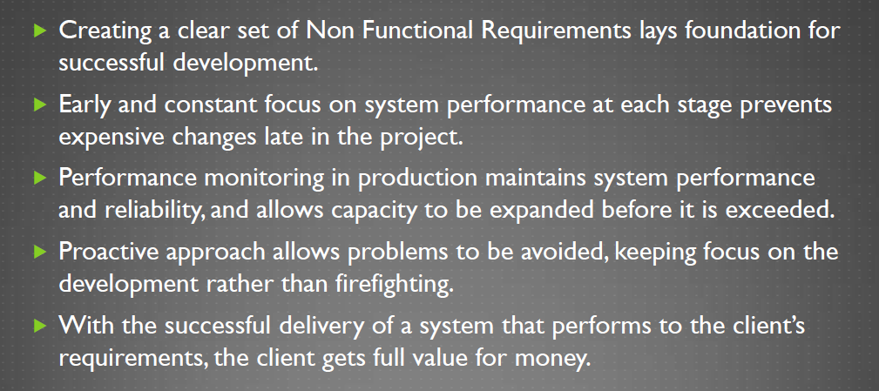
Advantages of Software Performance Engineering (SPE)
Raushan Kumar

Slide 6
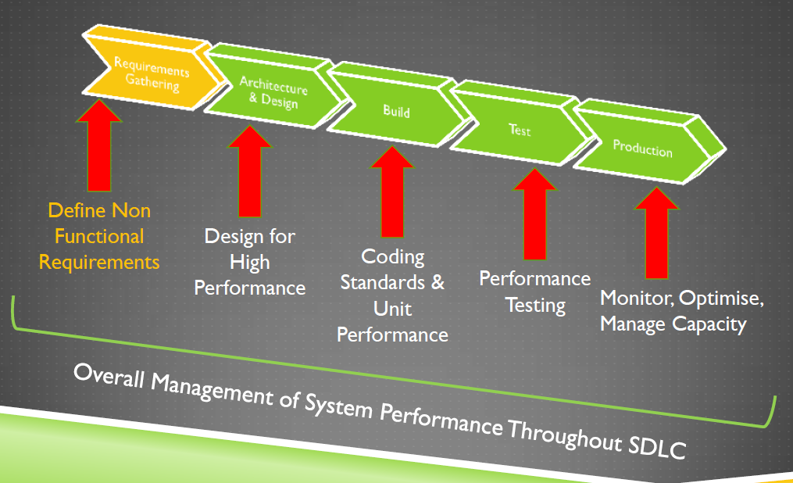
Requirements Analysis
Raushan Kumar

Slide 7
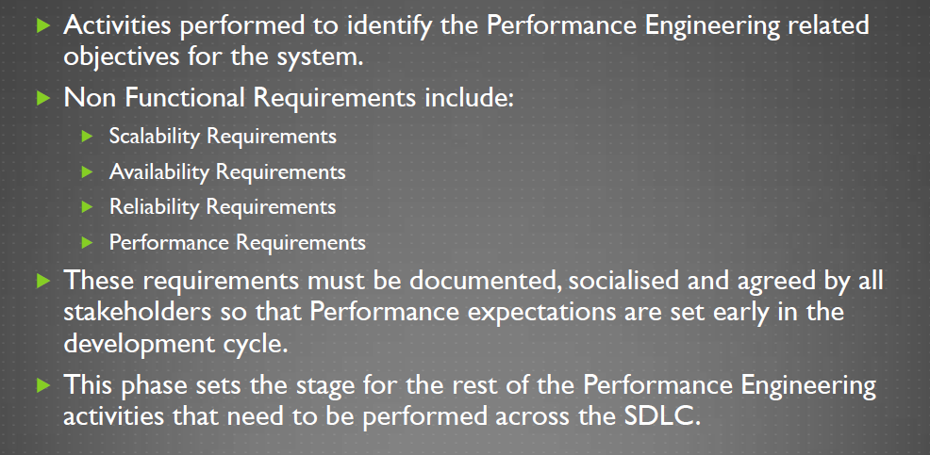
Definition - Requirements Analysis
Raushan Kumar

Slide 8
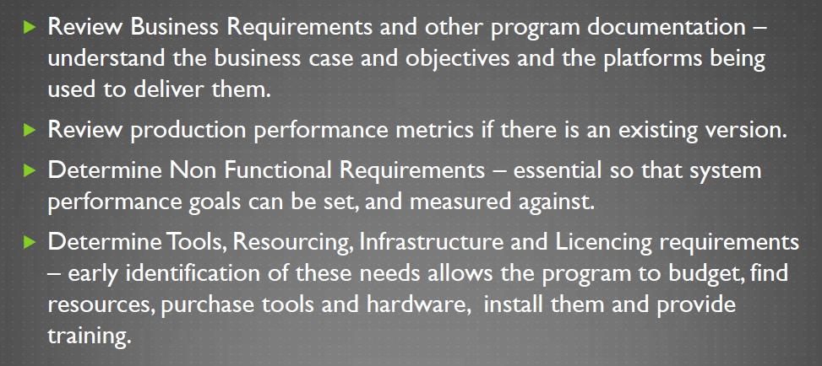
Requirements Analysis activities
Raushan Kumar

Slide 9
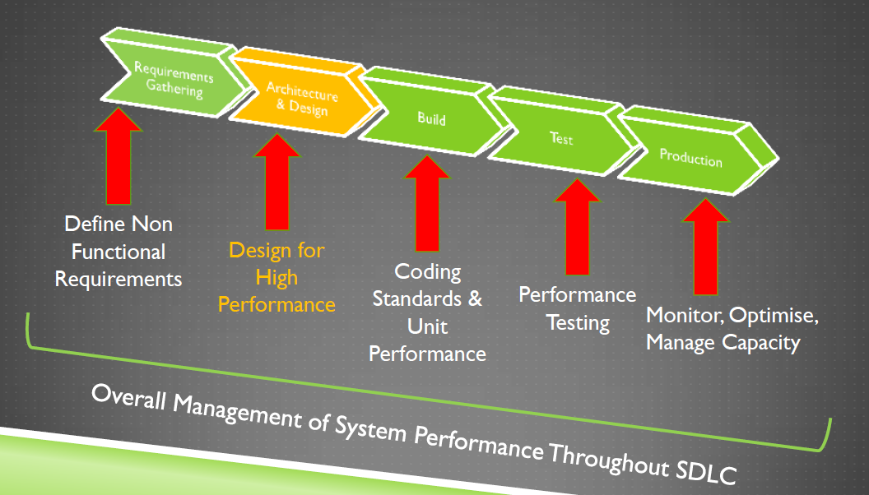
Design for Performance
Raushan Kumar

Slide 10
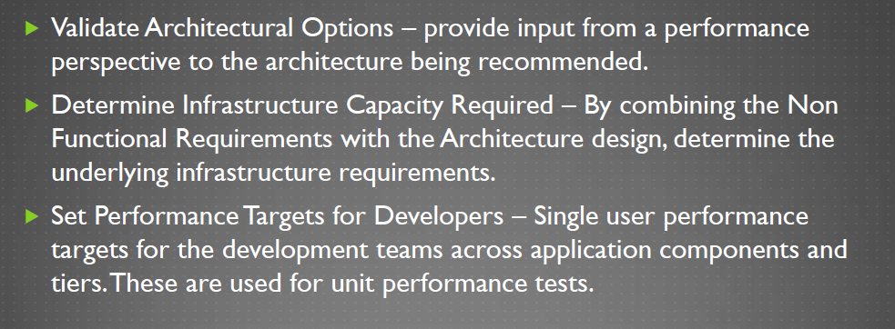
Design phase activities
Raushan Kumar

Slide 11
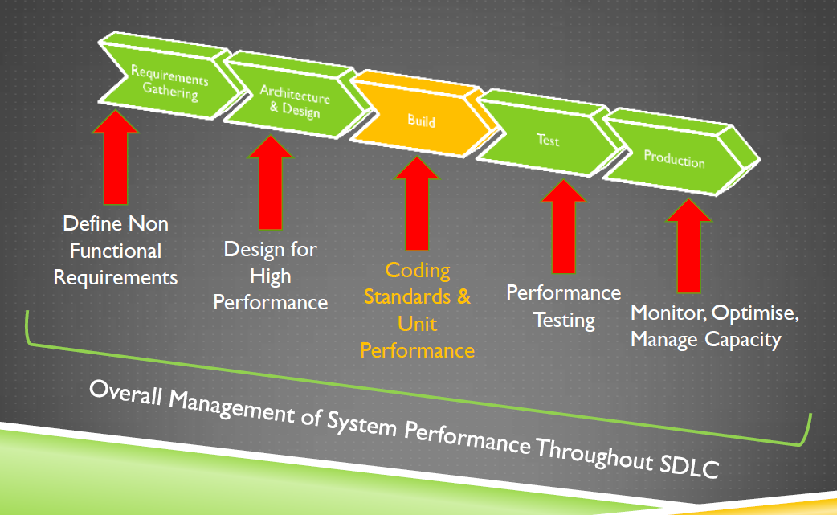
Build for Performance
Raushan Kumar

Slide 12
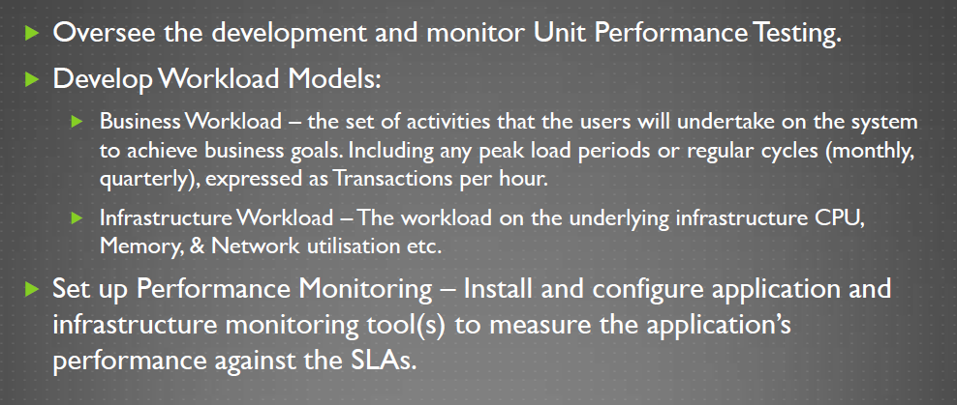
Build phase activities
Raushan Kumar

Slide 13
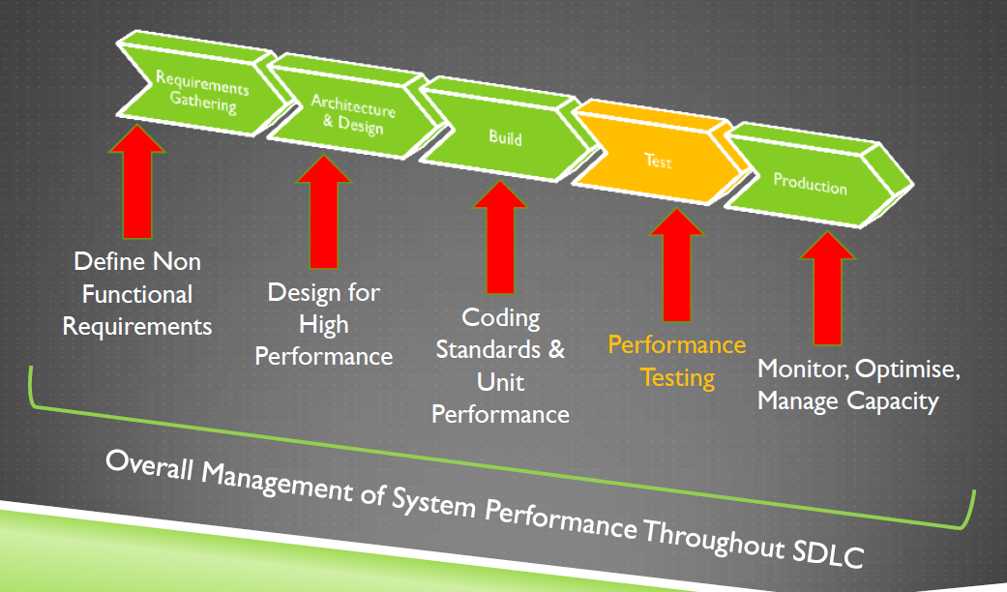
Performance Testing
Raushan Kumar

Slide 14
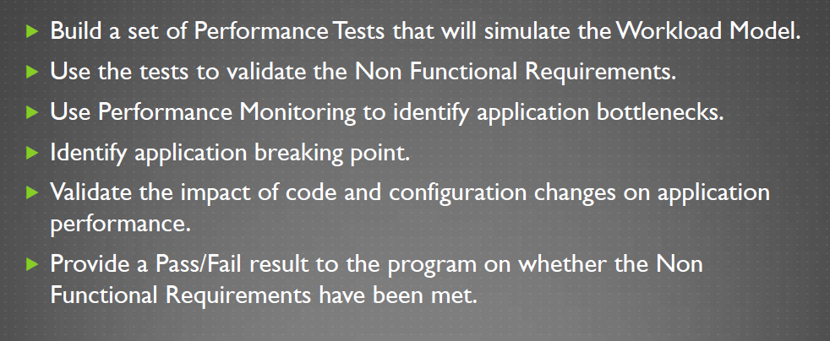
Performance Testing activities
Raushan Kumar

Slide 15
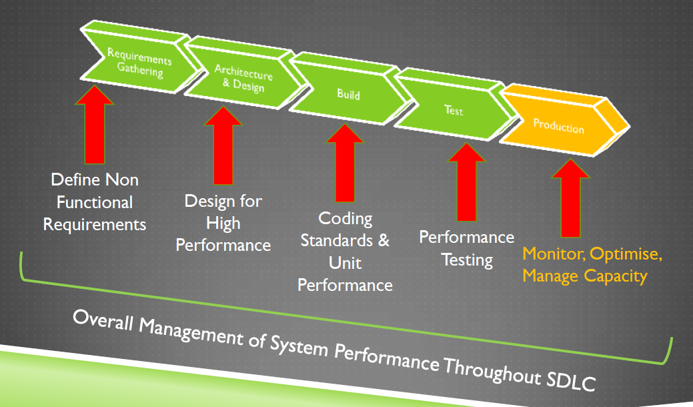
Production
Raushan Kumar

Slide 16
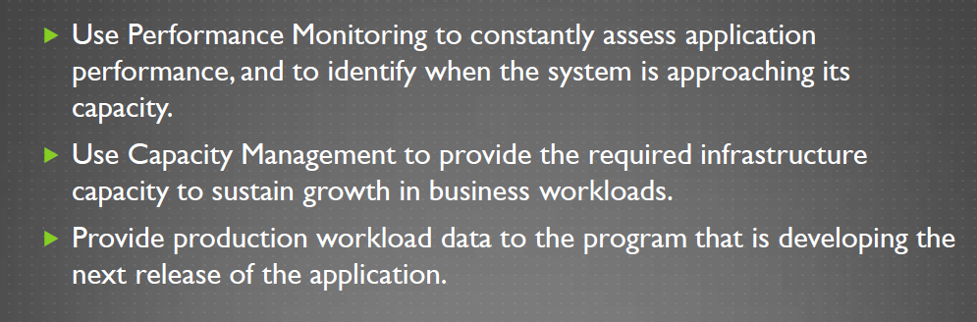
Maintaining Performance in Production
Raushan Kumar

Slide 17
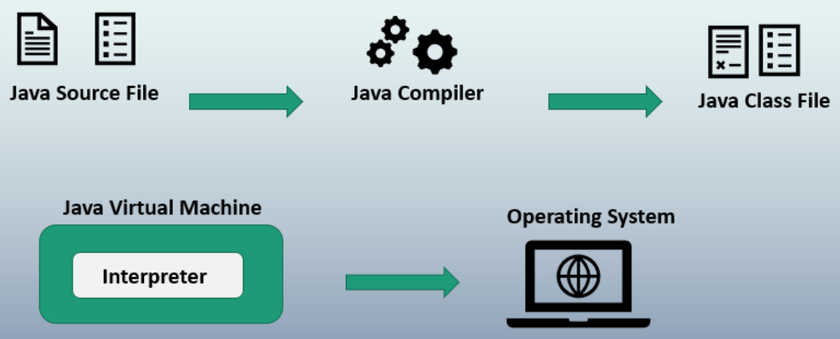
Java Program Execution
Raushan Kumar

Slide 18
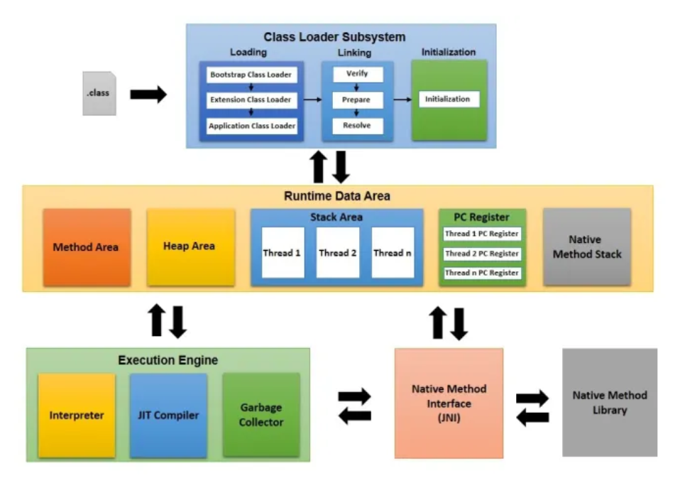
JVM Architecture
Raushan Kumar

Slide 19
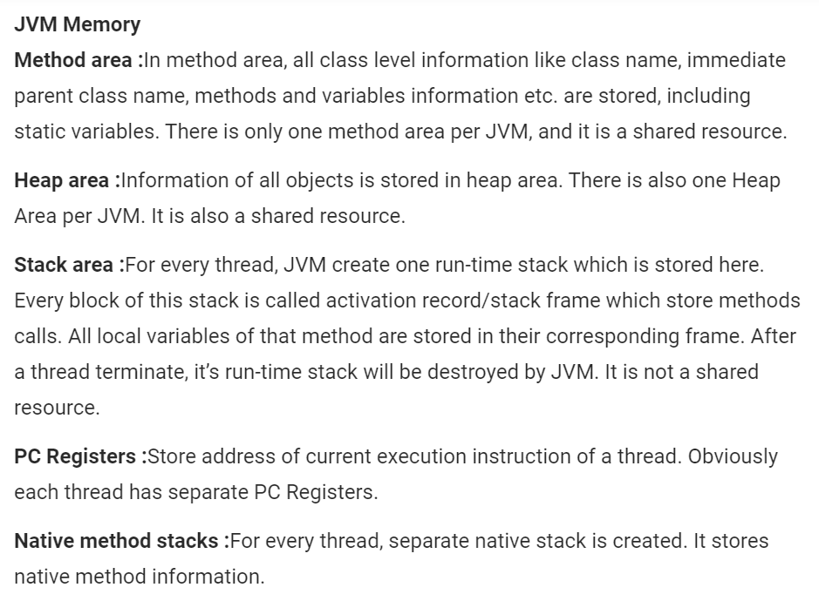
JVM Memory
Raushan Kumar

Slide 20
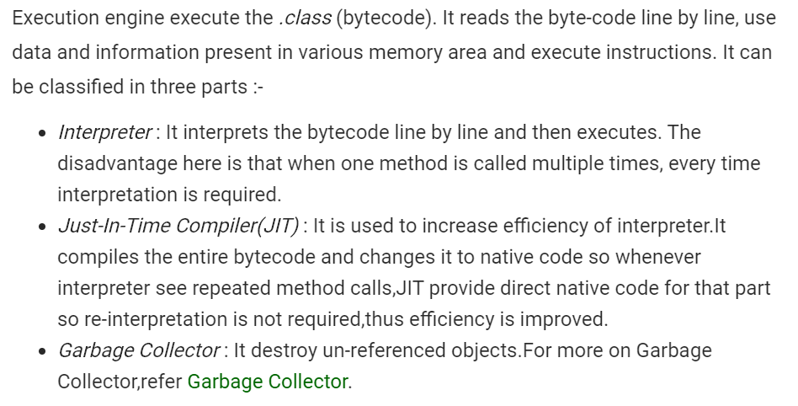
Execution Engine
Raushan Kumar

Slide 21
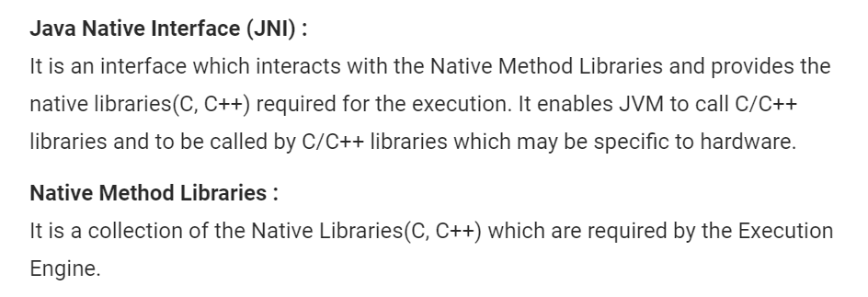
Other components
Raushan Kumar

Slide 22
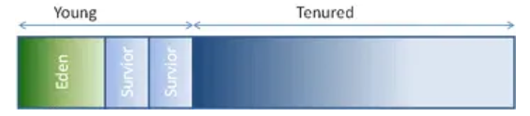
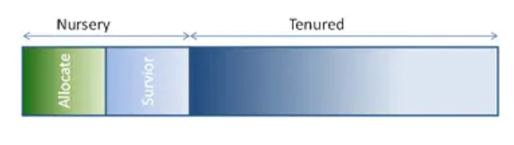
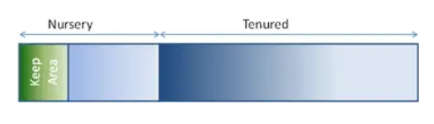
Not all JVMS are created Equal
https://www.dynatrace.com/resources/ebooks/javabook/the-three-jvms/
Oracle Hotspot JVM (formerly known as the Sun JVM)
IBM WebSphere JVM
Oracle JRockit
Raushan Kumar

Slide 23
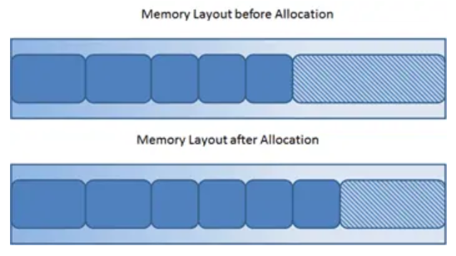
How Garbage Collection really works
https://www.dynatrace.com/resources/ebooks/javabook/how-garbage-collection-works/
Many people think garbage collection collects and discards dead objects.
In reality, Java garbage collection is doing the opposite!
Live objects are tracked and everything else designated garbage.
New objects are simply allocated at the end of the used heap
Raushan Kumar

Slide 24
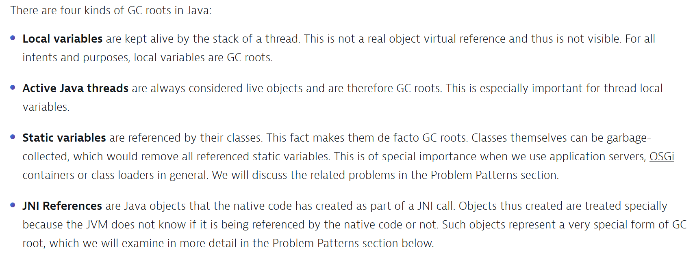
Garbage Collection Roots
A simple Java application has the following GC roots:
Local variables in the main method
The main thread
Static variables of the main class
Raushan Kumar

Slide 25
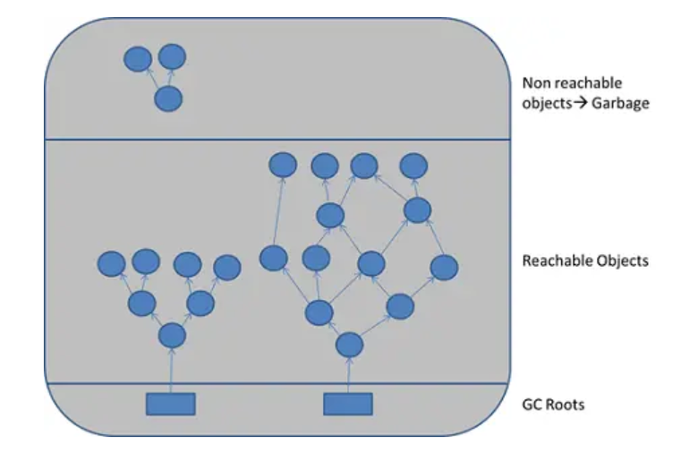
Garbage Collection Roots
GC roots are objects that are themselves referenced by the JVM and thus keep every other object from being garbage-collected.
Raushan Kumar

Slide 26
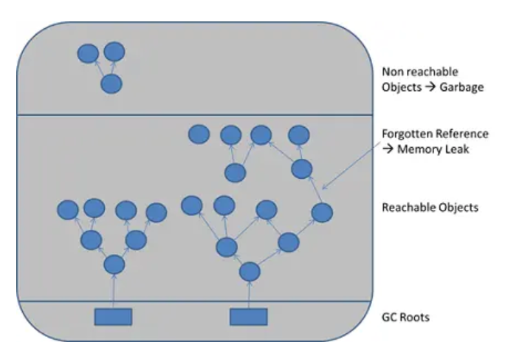
Mark-and-sweep algorithm
To determine which objects are no longer in use, the JVM intermittently runs what is very aptly called
a mark-and-sweep algorithm. As you might intuit, it's a straightforward, two-step process:
The algorithm traverses all object references, starting with the GC roots, and marks every object found as alive.
All of the heap memory that is not occupied by marked objects is reclaimed.
It is simply marked as free, essentially swept free of unused objects
When objects are no longer referenced directly or
indirectly by a GC root, they will be removed.
There are no classic memory leaks.
Analysis cannot really identify memory leaks;
it can only point out suspicious objects.
Raushan Kumar

Slide 27
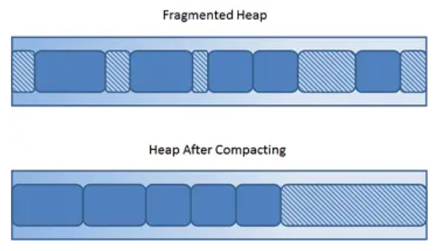
Compaction
Whenever we create a new object in Java, the JVM automatically allocates a block of memory large enough
to fit the new object on the heap. Repeated allocation and reclamation leads to memory fragmentation,
which is similar to disk fragmentation. Memory fragmentation leads to two problems:
Reduced allocation speed:
Allocation Errors:
Java avoids memory fragmentation by executing compaction
Raushan Kumar

Slide 28
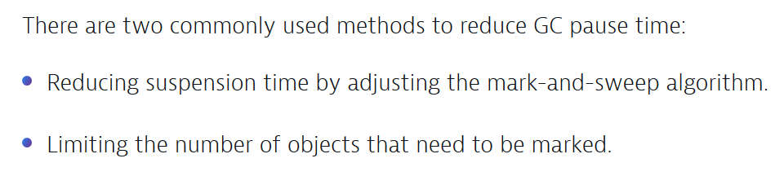
GC Pause time
High Object Creation Rate
Undersized Young Generation
Choice of GC Algorithm
Process Swapping
Tuning the Number of GC threads
Background IO traffic
System.gc() Calls
https://dzone.com/articles/how-to-reduce-long-gc-pause
Raushan Kumar

Slide 29
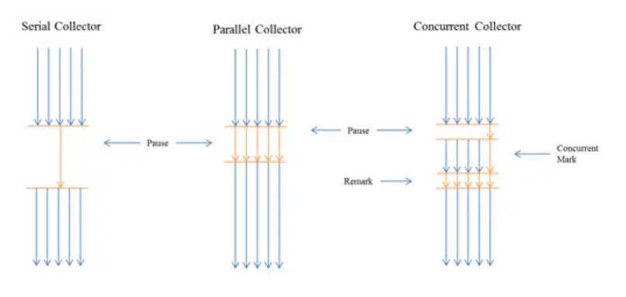
Reducing GC Pause Time Continued..
https://www.dynatrace.com/resources/ebooks/javabook/reduce-garbage-collection-pause-time/
Raushan Kumar

Slide 30
Parallel GC
Oracle Hotspot JVM
Objects are allocated in the Eden space, which is
always considerably larger than the survivor spaces
(default ratio is 1:8, but can be configured).
It always copies surviving objects from the Eden,
and currently used survivor into the second
(currently unused) survivor space.
Copying an object is, of course, more expensive than simply marking it, which is why the Eden space is
the biggest of the three young-generation spaces.
The vast majority of objects die in their infancy.
A bigger Eden will ensure that these objects will not survive the first GC cycle, and thus not be copied at all.
Once an object has survived multiple GC cycles (how many can be configured) it is tenured to the
old generation (the old generation is also referred to as tenured space).
The parallel collector is also a
compacting one, but the way it does the compaction can be configured with a wide variety of options.
Raushan Kumar

Slide 31
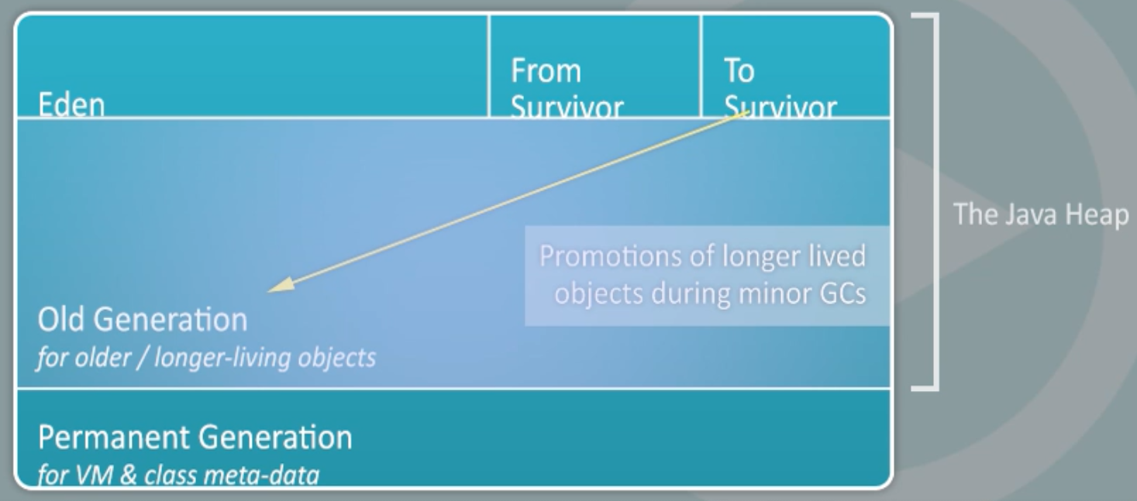
Heap Layout of JVM
Or MetaSpace
From Java 8, Permanent Generation (PermGen) is called MetaSpace.
Raushan Kumar

Slide 32
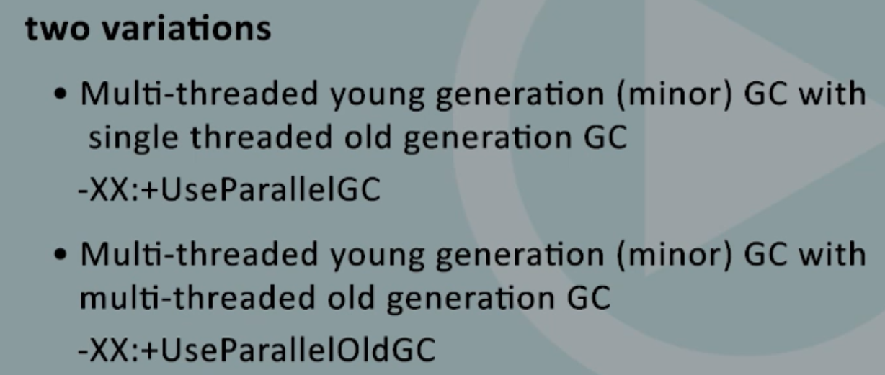
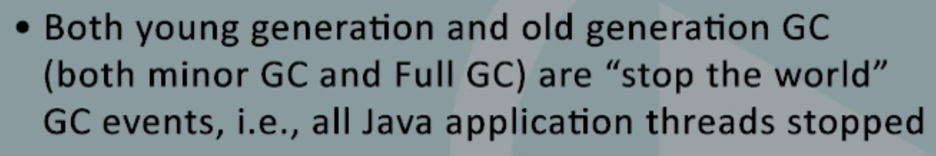
Parallel GC
Raushan Kumar

Slide 33
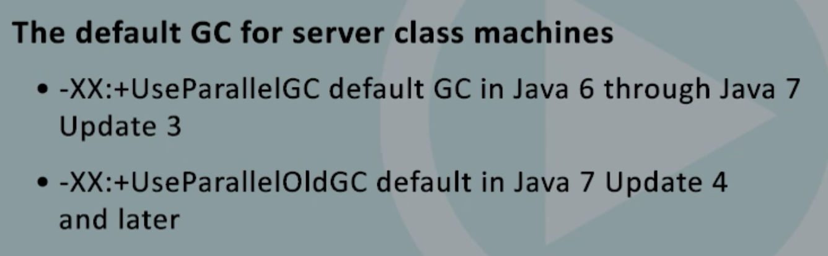
Parallel GC
Server Class Machines: System with at least 2 virtual processors and at least 2 GB of memory.
Raushan Kumar

Slide 34
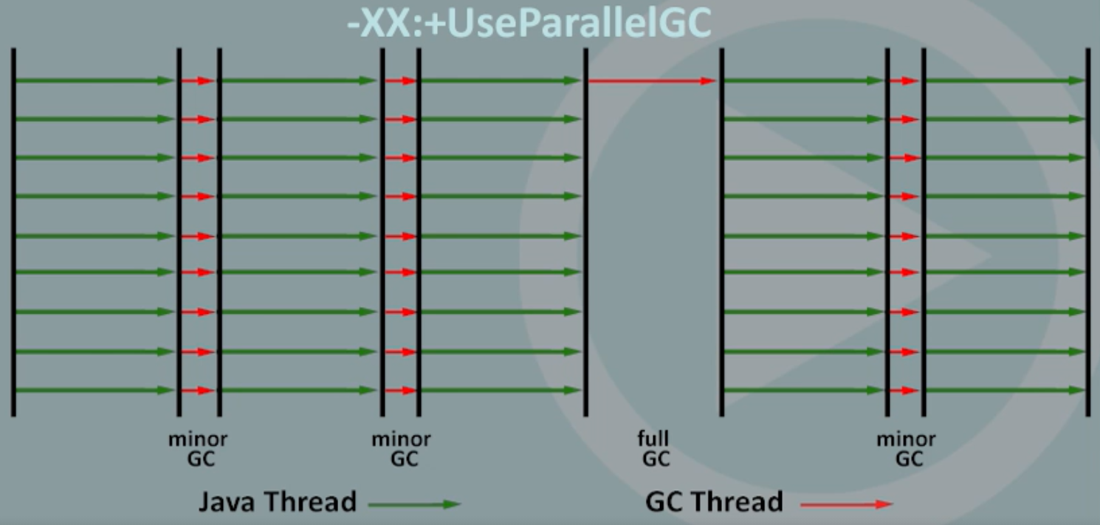
Parallel GC Illustration
Raushan Kumar

Slide 35
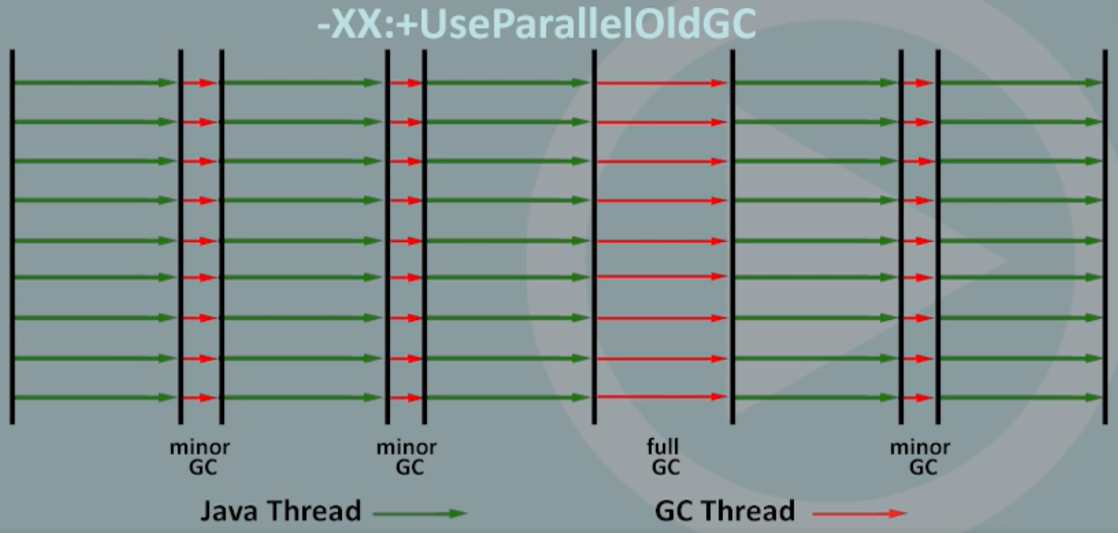
Parallel GC Illustration
Raushan Kumar

Slide 36
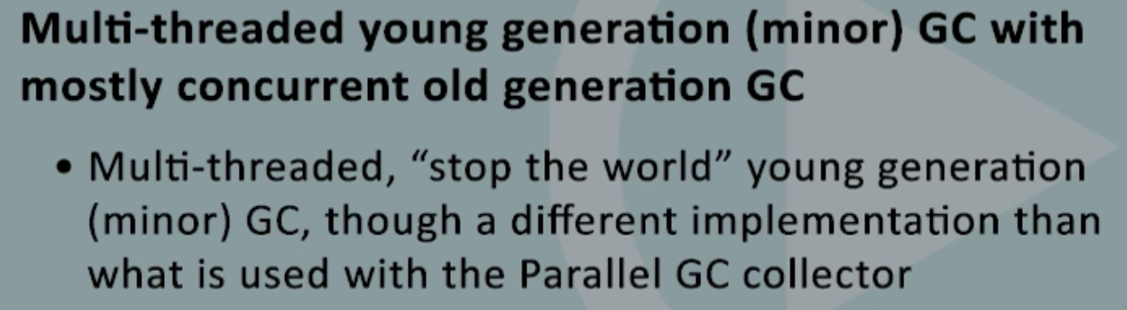
CMS GC
Raushan Kumar

Slide 37
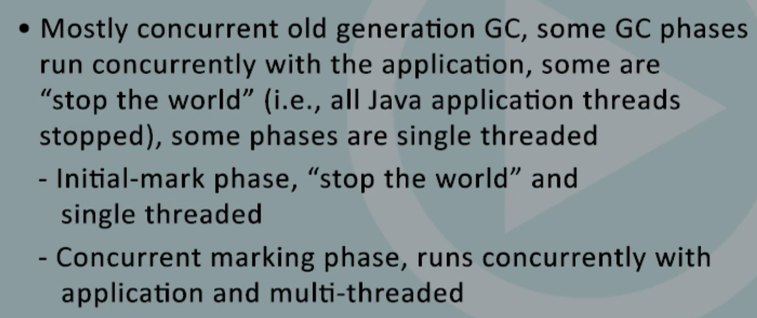
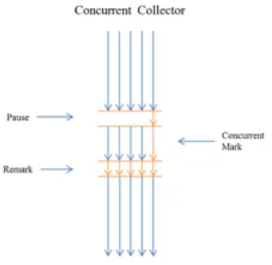
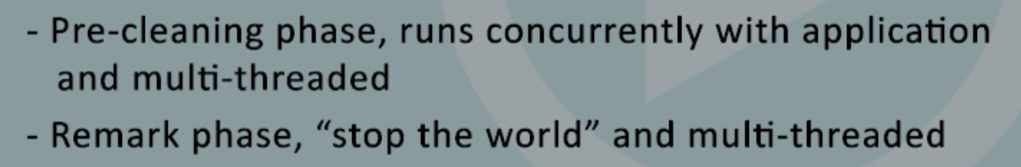
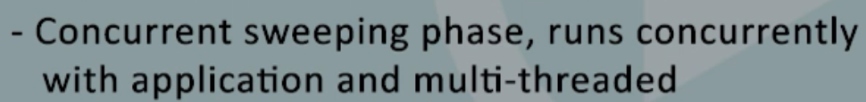
CMS GC
Raushan Kumar

Slide 38
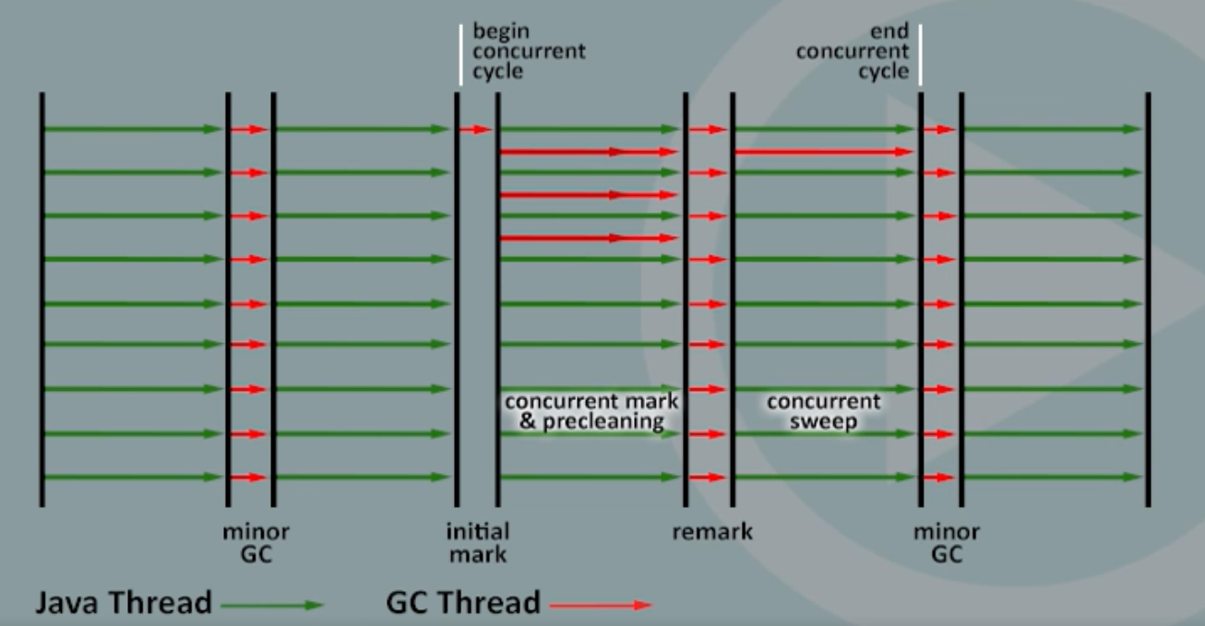
CMS GC
Raushan Kumar

Slide 39
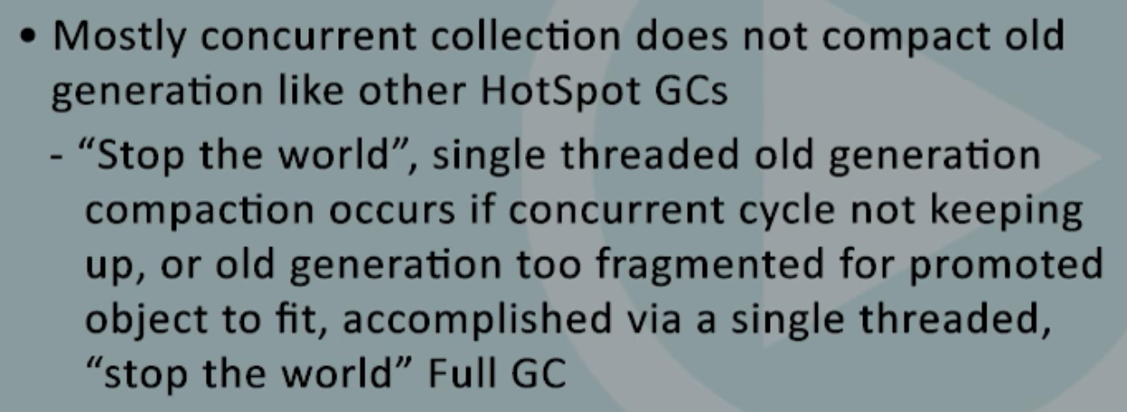
CMS GC
Raushan Kumar

Slide 40
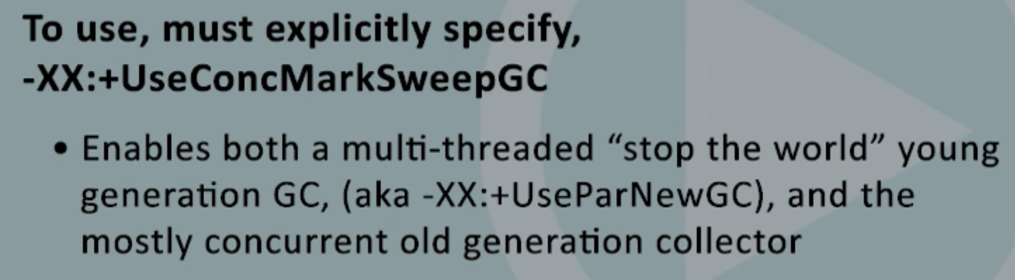
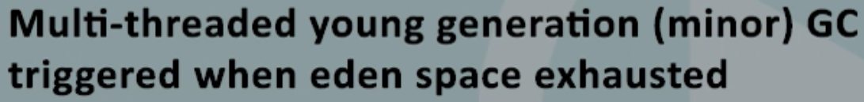
CMS GC
Raushan Kumar

Slide 41
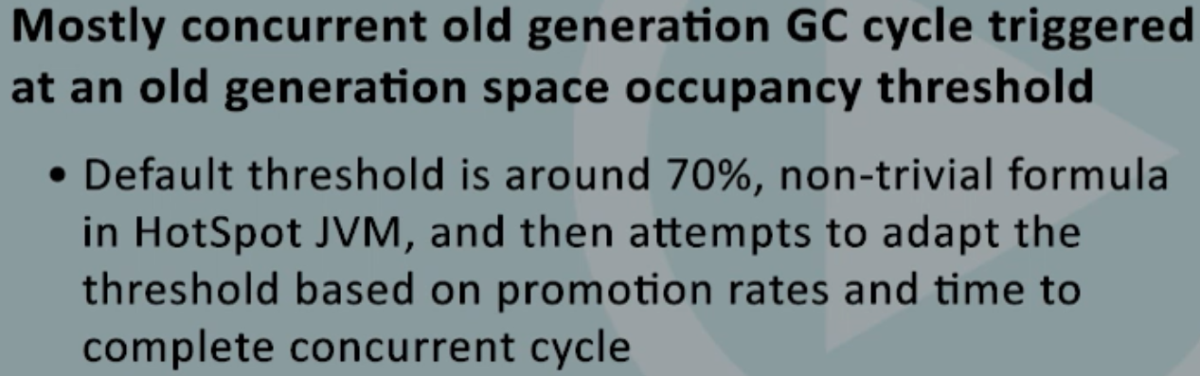
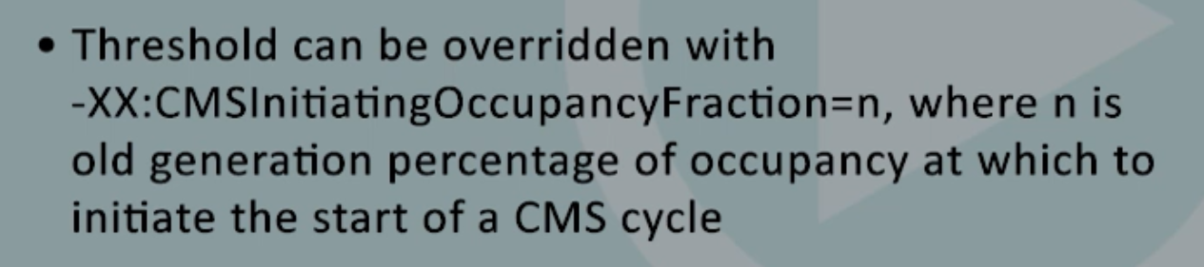
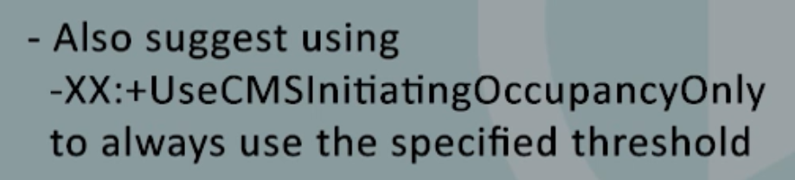
CMS GC
Raushan Kumar

Slide 42
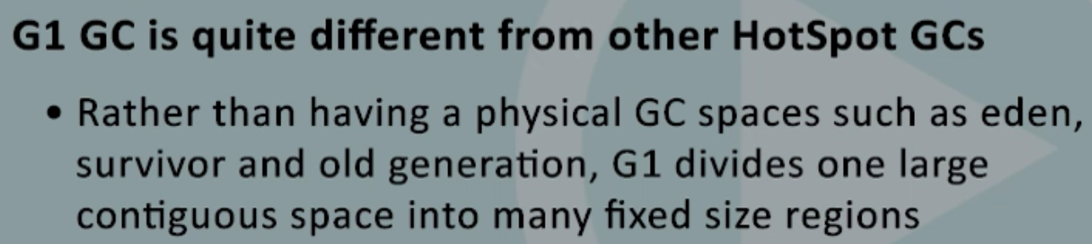

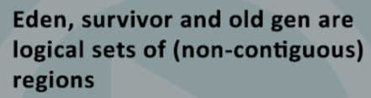


G1 GC
Raushan Kumar

Slide 43




G1 GC
Raushan Kumar

Slide 44

G1 GC
Raushan Kumar

Slide 45



G1 GC
Raushan Kumar

Slide 46


G1 GC
Raushan Kumar

Slide 47

G1 GC
https://www.oracle.com/technical-resources/articles/java/g1gc.html
Raushan Kumar

Slide 48



G1 GC
Raushan Kumar

Slide 49




G1 GC
(Pause time)
Raushan Kumar

Slide 50

G1 GC Illustration
Raushan Kumar

Slide 51



G1 GC Illustration –XX:+UseG1GC
Raushan Kumar

Slide 52

G1 GC
Raushan Kumar

Slide 53

G1 GC
Raushan Kumar

Slide 54

Additional G1 GC Options
Raushan Kumar

Slide 55

Additional G1 GC Options
Raushan Kumar

Slide 56


JVM Performance Metrics to Monitor
Raushan Kumar

Slide 57

JVM Performance Metrics to Monitor
https://dzone.com/articles/java-runtime-performance-monitoring-gc-and-safepoi
Raushan Kumar

Slide 58

JVM Performance Metrics to Monitor
Raushan Kumar

Slide 59

Log Options
Raushan Kumar

Slide 60

User CPU
Raushan Kumar

Slide 61

System CPU
Raushan Kumar

Slide 62
GC Log – Parallel Garbage Collector
https://plumbr.io/handbook/garbage-collection-algorithms-implementations/parallel-gc
Raushan Kumar

Slide 63

Allocation/Promotion Failure
Promotion Failure https://plumbr.io/handbook/gc-tuning-in-practice
Raushan Kumar

Slide 64

GC Logs Key Points
Raushan Kumar

Slide 65

GC Logs Key Points
Raushan Kumar

Slide 66
GC Log – CMS Garbage Collector
https://plumbr.io/handbook/garbage-collection-algorithms-implementations#concurrent-mark-and-sweep
Raushan Kumar

Slide 67
GC Log – G1 Garbage Collector
https://plumbr.io/handbook/garbage-collection-algorithms-implementations#g1
Raushan Kumar

Slide 68
GC Tuning - Tooling
https://plumbr.io/handbook/gc-tuning-measuring
Raushan Kumar

Slide 69
JVisualVM AWS EC2 Remote Connection
http://msnider.github.io/blog/2014/01/07/visualvm-on-a-remote-ec2-instance-over-an-ssh-tunnel/
https://codetips.coloza.com/2017/07/visualvm-remote-ec2-over-ssh.html
https://stackoverflow.com/questions/19130877/why-does-jmx-connection-to-amazon-ec2-fail
Video Reference
https://www.youtube.com/watch?v=e8gMt0wixls
Raushan Kumar

Slide 70

JVM Heap Dump Analysis – Shallow & Retained heap
Raushan Kumar

Slide 71

JVM Heap Dump Analysis – Histogram ->List Objects
Raushan Kumar

Slide 72

JVM Heap Dump Analysis – Leak Suspects
Raushan Kumar

Slide 73

JVM Heap Dump Analysis – Finding Leak Object
Raushan Kumar

Slide 74

JVM Heap Dump Analysis – Top Consumers
Raushan Kumar

Slide 75


Comparing Heap Dump – Histogram
Load other heap dumps and compare
Raushan Kumar

Slide 76



Heap Dump Analysis – jhat
Localhost:7000
Raushan Kumar

Slide 77
Java Performance
https://docs.oracle.com/javase/tutorial/index.html
https://www.dynatrace.com/resources/ebooks/javabook/performance-engineering/
https://www.oracle.com/webfolder/technetwork/tutorials/obe/java/gc01/index.html
https://docs.oracle.com/javase/7/docs/technotes/guides/management/monitoringguide.html
https://www.oracle.com/java/technologies/tuning-garbage-collection-v50-java-virtual-machine.html
https://www.oracle.com/java/technologies/javase/javase-core-technologies-apis.html
https://www.oracle.com/java/technologies/javase/gc-tuning-6.html
https://docs.oracle.com/javase/9/gctuning/JSGCT.pdf
https://www.oracle.com/java/technologies/javase/hotspot-garbage-collection.html
https://docs.oracle.com/javase/7/docs/technotes/tools/windows/java.html
https://docs.oracle.com/javase/8/docs/technotes/guides/troubleshoot/tooldescr.html
Raushan Kumar

Slide 78

Q & A
Raushan Kumar
Notes:
In Slide Show mode, select the arrows to visit links.

Slide 79
Thank You!
Raushan Kumar

